Slide 2
solve problems based on principal computation.

Slide 3
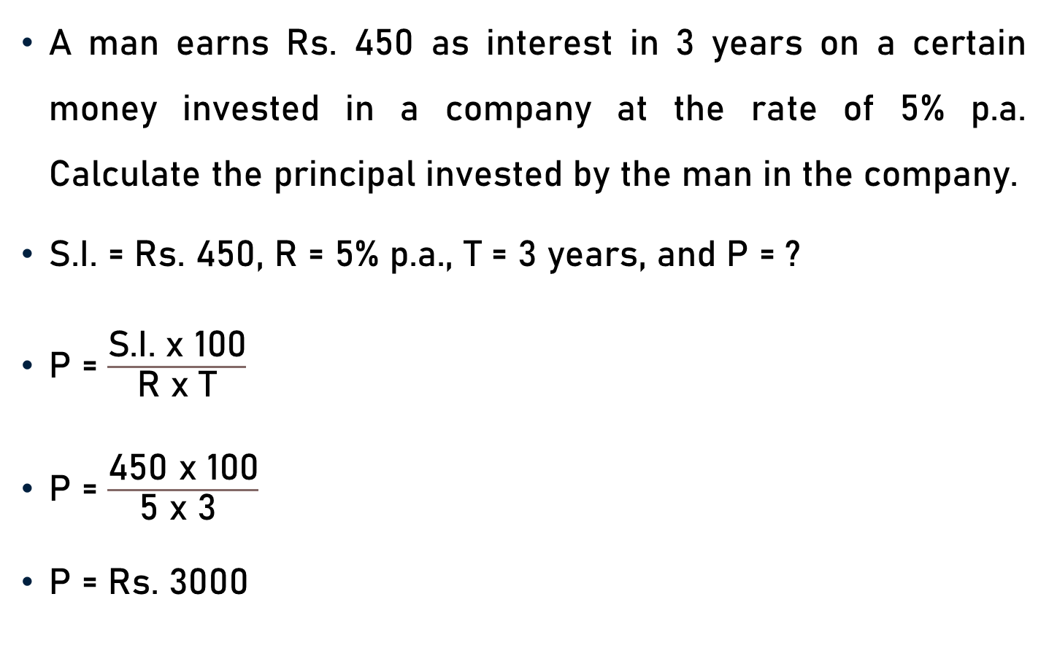
Problem 1
A man earns Rs. 450 as interest in 3 years on a certain money invested in a company at the rate of 5% p.a. Calculate the principal invested by the man in the company.
S.I. = Rs. 450, R = 5% p.a., T = 3 years, and P = ?
P = $\frac{\text{S}\text{.}\text{I}\text{. }\text{x}\text{ 100}}{\text{R} \text{x} \text{T}}$
P = $\frac{\text{450} \text{x}\text{ 100}}{\text{5 }\text{x}\text{ 3 }}$
P = Rs. 3000
30
150

Slide 4
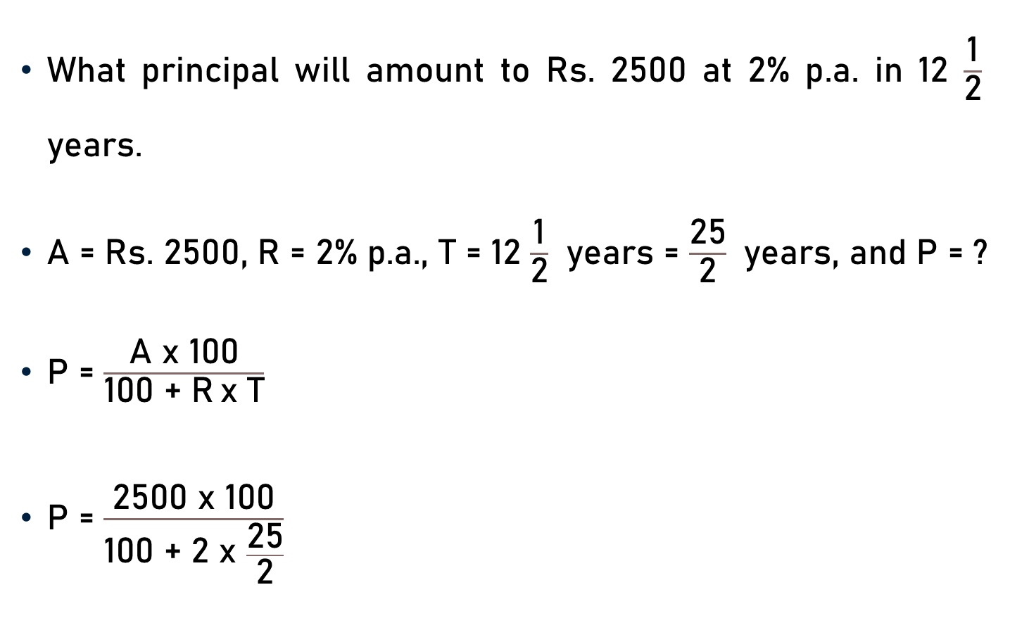
Problem 2
What principal will amount to Rs. 2500 at 2% p.a. in 12 $\frac{\text{1}}{\text{2}}$ years.
A = Rs. 2500, R = 2% p.a., T = 12 $\frac{\text{1}}{\text{2}}$ years = $\frac{\text{25}}{\text{2}}$ years, and P = ?
$\text{P}$ = $\frac{\text{A} \text{x}\text{ 100}}{\text{100 + }\text{R} \text{x} \text{T}}$
P = $\frac{\text{2500} \text{x}\text{ 100}}{\text{100} \text{+ 2 }\text{x} \frac{\text{25}}{\text{2}}}$

Slide 5

Problem 2
P = $\frac{\text{2500} \text{x}\text{ 100}}{\text{100} \text{+ 25 }}$
P = $\frac{\text{250000}}{\text{1}\text{25} }$
P = Rs. 2000
2000

Slide 6
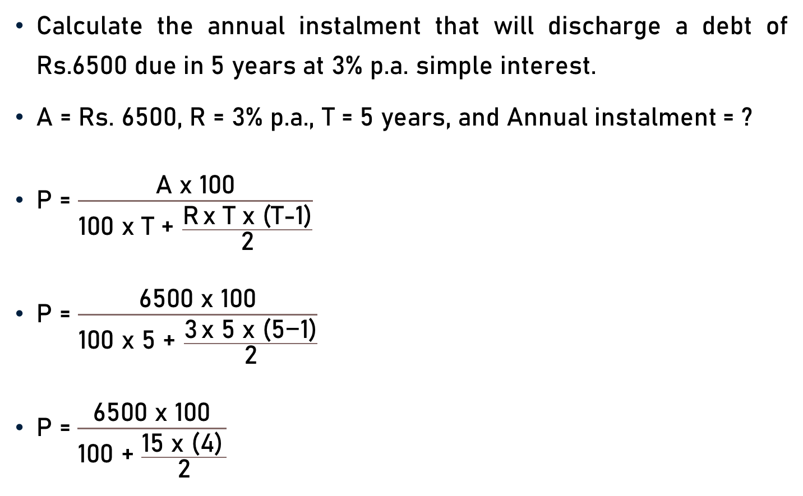
Problem 3
Calculate the annual instalment that will discharge a debt of Rs.6500 due in 5 years at 3% p.a. simple interest.
A = Rs. 6500, R = 3% p.a., T = 5 years, and Annual instalment = ?
$\text{P}$ = $\frac{\text{A} \text{x}\text{ 100}}{\text{100 }\text{x} \text{T}\text{ +} \frac{\text{R} \text{x} \text{T} \text{x}\text{ (}\text{T}\text{−1)}}{\text{2}}}$
$\text{P}$ = $\frac{\text{6500} \text{x}\text{ 100}}{\text{100 }\text{x}\text{ 5 +} \frac{\text{3} \text{x}\text{ 5 }\text{x}\text{ (}\text{5}\text{−1)}}{\text{2}}}$
P = $\frac{\text{6500} \text{x}\text{ 100}}{\text{100} \text{+ }\frac{\text{1}\text{5} \text{x}\text{ (4)} }{\text{2}}}$
2

Slide 7

Problem 3
P = $\frac{\text{6500} \text{x}\text{ 100}}{\text{100} \text{+ 30 }}$
P = $\frac{\text{6}\text{50000}}{\text{1}\text{3}\text{0 }}$
P = Rs. 5000
5000

Slide 8
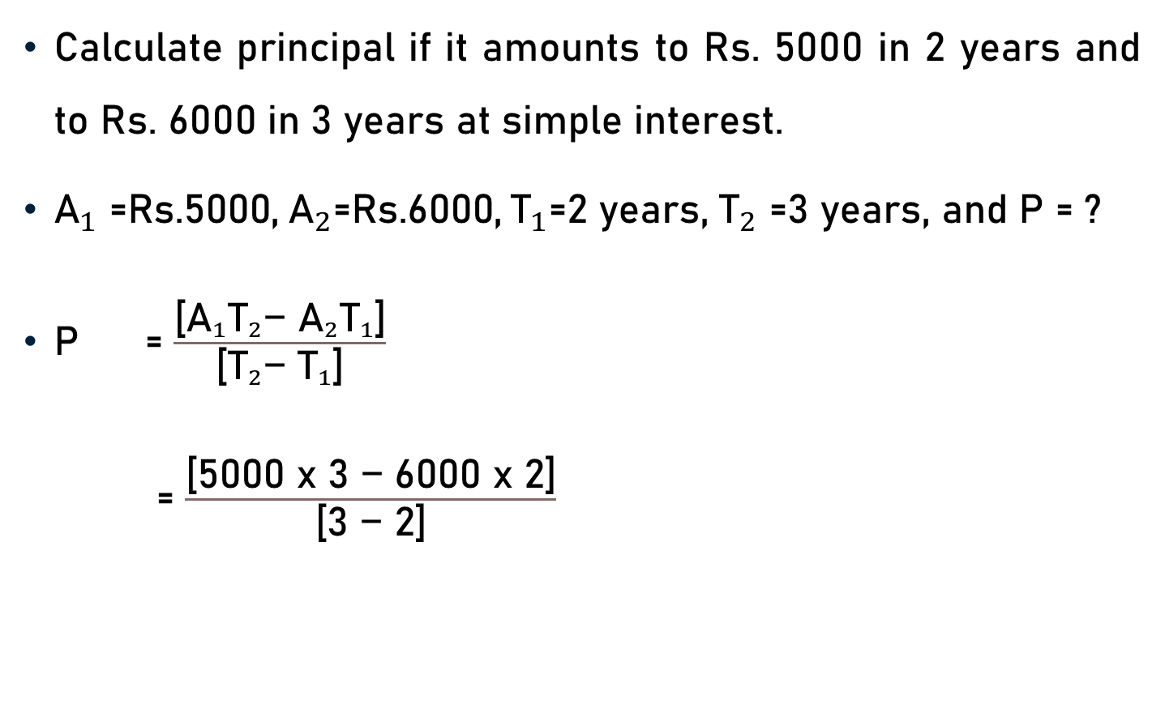
Problem 4
Calculate principal if it amounts to Rs. 5000 in 2 years and to Rs. 6000 in 3 years at simple interest.
${\text{A}}_{1}{\text{=}\text{Rs}\text{.}\text{5}\text{000,} { \text{A}}_{2}\text{=}\text{Rs}\text{.6000,}{ \text{T}}_{1}\text{=}\text{2 }\text{years}\text{, }\text{T}}_{2}\text{=}\text{3} \text{years}\text{, }\text{and} \text{P}\text{ = ?}$
$\text{P}$ = $\frac{\text{[}{\text{A}}_{1}{\text{T}}_{2}\text{−} {\text{A}}_{2}{\text{T}}_{1}\text{]}}{\text{[}{\text{T}}_{2}\text{−} {\text{T}}_{1}\text{]}}$
= $\frac{\text{[}\text{5000 }\text{x}\text{ 3 }\text{−}\text{ 6}\text{000 }\text{x}\text{ 2]}}{\text{[}\text{3 }\text{−}\text{ 2}\text{]}}$

Slide 9

Problem 4
$\text{P}$ = $\frac{\text{[}\text{15}\text{000} \text{−} \text{12}\text{000]}}{\text{[3 }\text{−}\text{ 2]}}$
= $\frac{\text{[}\text{30}\text{00]}}{\text{[}\text{1}\text{]}}$
= Rs. 3000

Slide 10
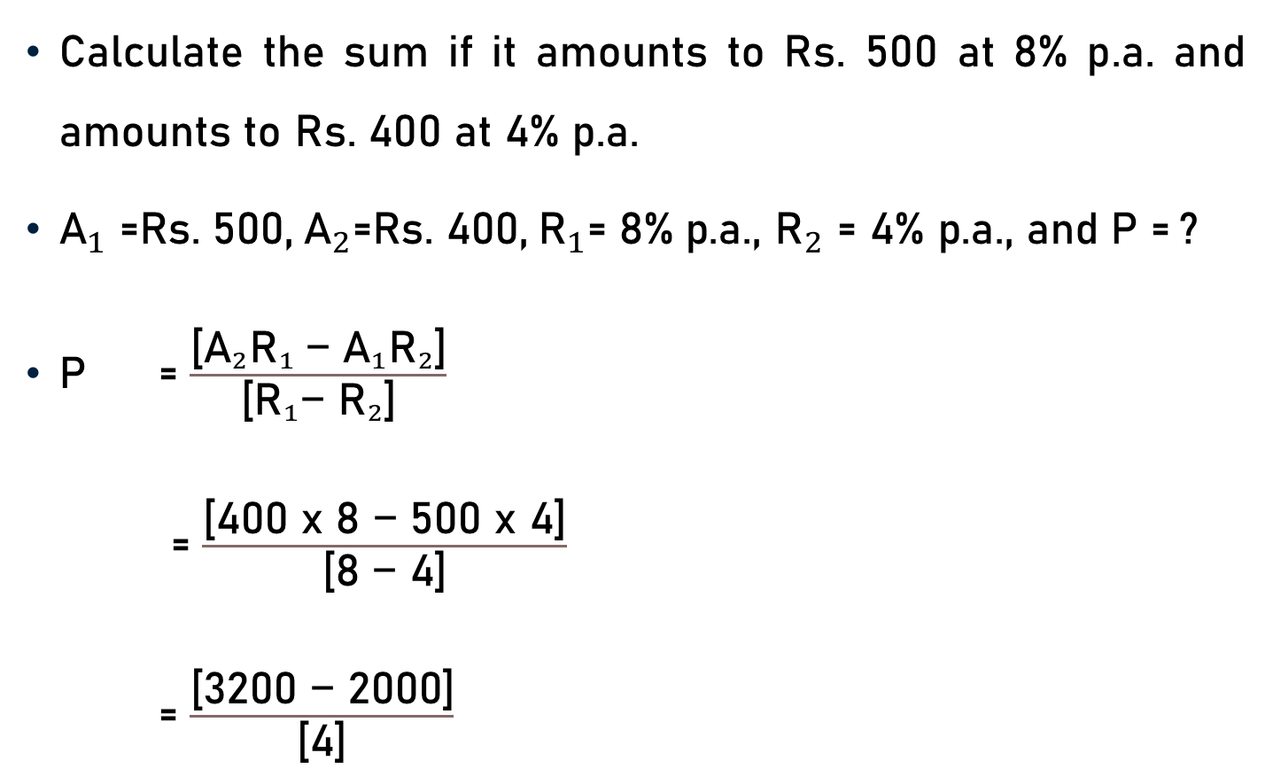
Problem 5
Calculate the sum if it amounts to Rs. 500 at 8% p.a. and amounts to Rs. 400 at 4% p.a.
${\text{A}}_{1}{\text{=}\text{Rs}\text{.} \text{500,} { \text{A}}_{2}\text{=}\text{Rs}\text{.} \text{400,}{ \text{R}}_{1}\text{=}\text{ 8\% }\text{p}\text{.}\text{a}\text{., }\text{R}}_{2}\text{=}$ $\text{4\% }\text{p}\text{.}\text{a}\text{.}$, $\text{and} \text{P}$= ?
$\text{P}$ = $\frac{\text{[}{{\text{A}}_{2}{\text{R}}_{1} \text{−} \text{A}}_{1}{\text{R}}_{2}\text{]}}{\text{[}{{\text{R}}_{1}\text{−} \text{R}}_{2}\text{]}}$
= $\frac{\text{[}\text{400 }\text{x}\text{ 8 }\text{−}\text{ 5}\text{00 }\text{x}\text{ 4]}}{\text{[}\text{8 }\text{−}\text{ 4}\text{]}}$
= $\frac{\text{[}\text{32}\text{00 }\text{−} \text{20}\text{00]}}{\text{[}\text{4}\text{]}}$

Slide 11

Problem 5
$\text{P}$ = $\frac{\text{[}\text{32}\text{00 }\text{−} \text{20}\text{00]}}{\text{[}\text{4}\text{]}}$
= $\frac{\text{[1}\text{2}\text{00]}}{\text{[}\text{4}\text{]}}$
= Rs. 300
300

Slide 12
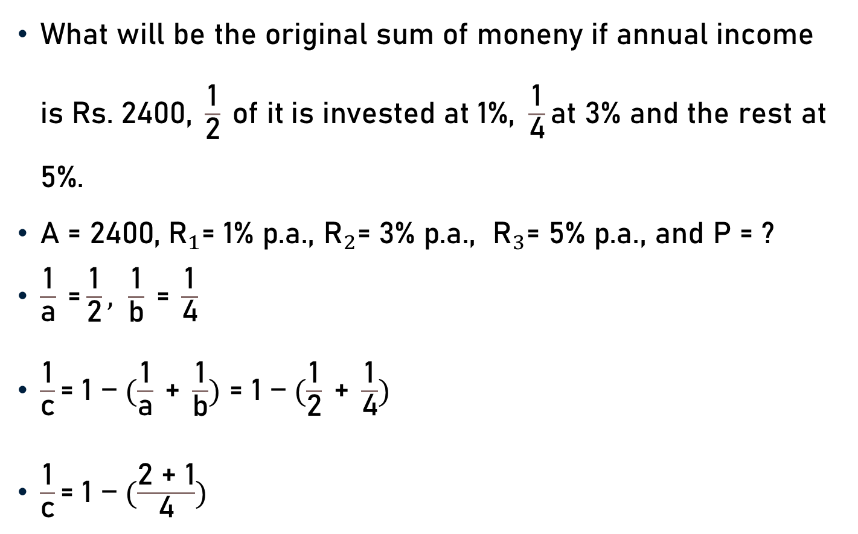
Problem 6
$\text{What} \text{will} \text{be} \text{the} \text{original} \text{sum} \text{of} \text{moneny} \text{if} \text{annual} \text{income} \text{is} \text{Rs}\text{. 2400, }\frac{\text{1}}{\text{2}} \text{of} \text{it} \text{is} \text{invested} \text{at}\text{ 1\%,} \frac{\text{1}}{\text{4}}\text{at}\text{ 3\% }\text{and} \text{the} \text{rest} \text{at}\text{ 5\%. }$
${\text{A}\text{ = 2400,}{ \text{R}}_{1}\text{= 1\% }\text{p}\text{.}\text{a}\text{., }\text{R}}_{2}\text{= 3\% }\text{p}\text{.}\text{a}\text{., }{ \text{R}}_{3}\text{= 5\% }\text{p}\text{.}\text{a}\text{.}$, $\text{and}$ P = ?
$\frac{\text{1}}{\text{a}} \text{=}\frac{\text{1}}{\text{2}}, \frac{\text{1}}{\text{b}} \text{=} \frac{\text{1}}{\text{4}}$
$\frac{\text{1}}{\text{c}}\text{= 1 −} (\frac{\text{1}}{\text{a}} \text{+} \frac{\text{1}}{\text{b}}) \text{= 1 −} (\frac{\text{1}}{\text{2}} \text{+} \frac{\text{1}}{\text{4}})$
$\frac{\text{1}}{\text{c}}\text{= 1 −} (\frac{\text{2 + 1}}{\text{4}})$

Slide 13
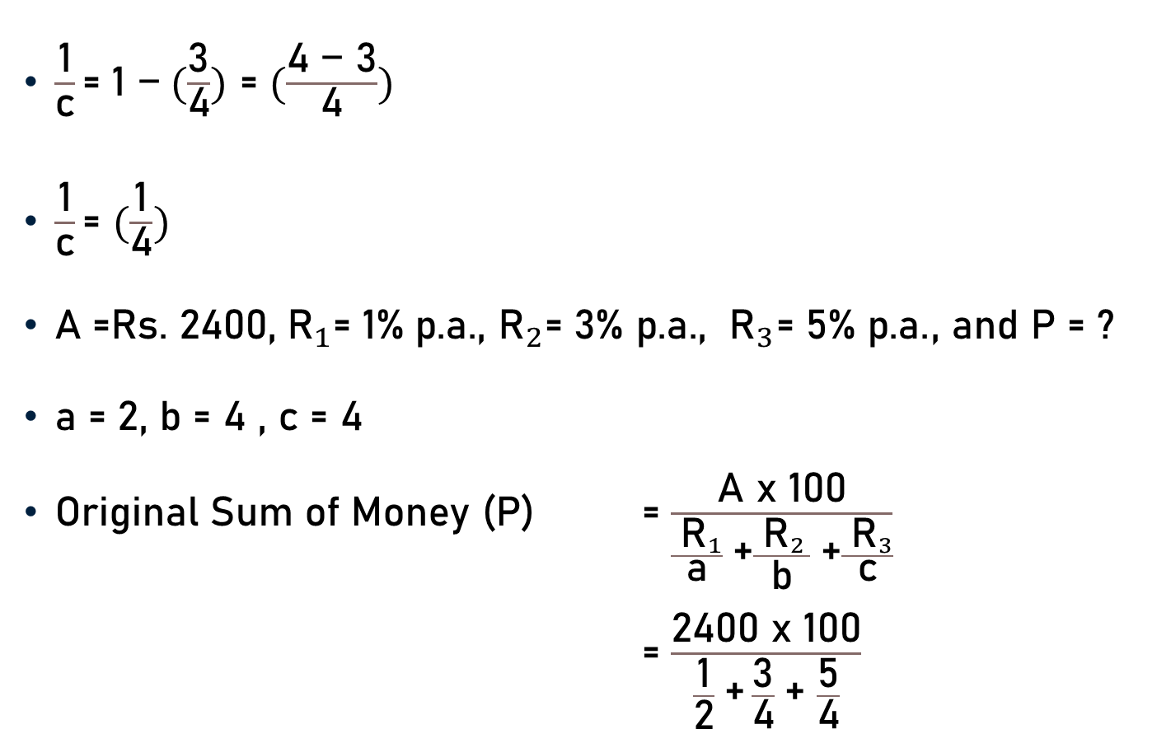
Problem 6
$\frac{\text{1}}{\text{c}}\text{= 1 }\text{−} (\frac{\text{3}}{\text{4}})$ $\text{=}$ $(\frac{\text{4 − 3}}{\text{4}})$
$\frac{\text{1}}{\text{c}}\text{=}$ $(\frac{\text{1}}{\text{4}})$
${\text{A}\text{ =}\text{Rs}\text{.} \text{2400,}{ \text{R}}_{1}\text{= 1\% }\text{p}\text{.}\text{a}\text{., }\text{R}}_{2}\text{= 3\% }\text{p}\text{.}\text{a}\text{., }{ \text{R}}_{3}\text{= 5\% }\text{p}\text{.}\text{a}\text{.}$, $\text{and}$ P = ?
$\text{a}\text{ = 2, }\text{b}\text{ = 4 , }\text{c}\text{ = 4}$
$\text{Original} \text{Sum} \text{of} \text{Money}$ (P) = $\frac{\text{A} \text{x}\text{ 100}}{\frac{{ \text{R}}_{1}}{\text{a}} \text{+}\frac{{ \text{R}}_{2 }}{\text{b}} \text{+}\frac{{ \text{R}}_{3}}{\text{c}}}$
= $\frac{\text{2400} \text{x}\text{ 100}}{\frac{\text{1}}{\text{2}} \text{+} \frac{\text{3}}{\text{4}} \text{+} \frac{\text{5}}{\text{4}}}$

Slide 14

Problem 6
$\text{Original} \text{Sum} \text{of} \text{Money}$ = $\frac{\text{2400} \text{x}\text{ 100}}{\frac{\text{1}}{\text{2}} \text{+} \frac{\text{3}}{\text{4}} \text{+} \frac{\text{5}}{\text{4}}}$
= $\frac{\text{240000}}{\frac{\text{2 + 3 + 5}}{\text{4}} }$
= $\frac{\text{240000}}{\frac{\text{10}}{\text{4}} }$
= $\frac{\text{240000} \text{x}\text{ 4}}{\text{10}}$
= Rs. $\text{96000}$
24000
1

Slide 15
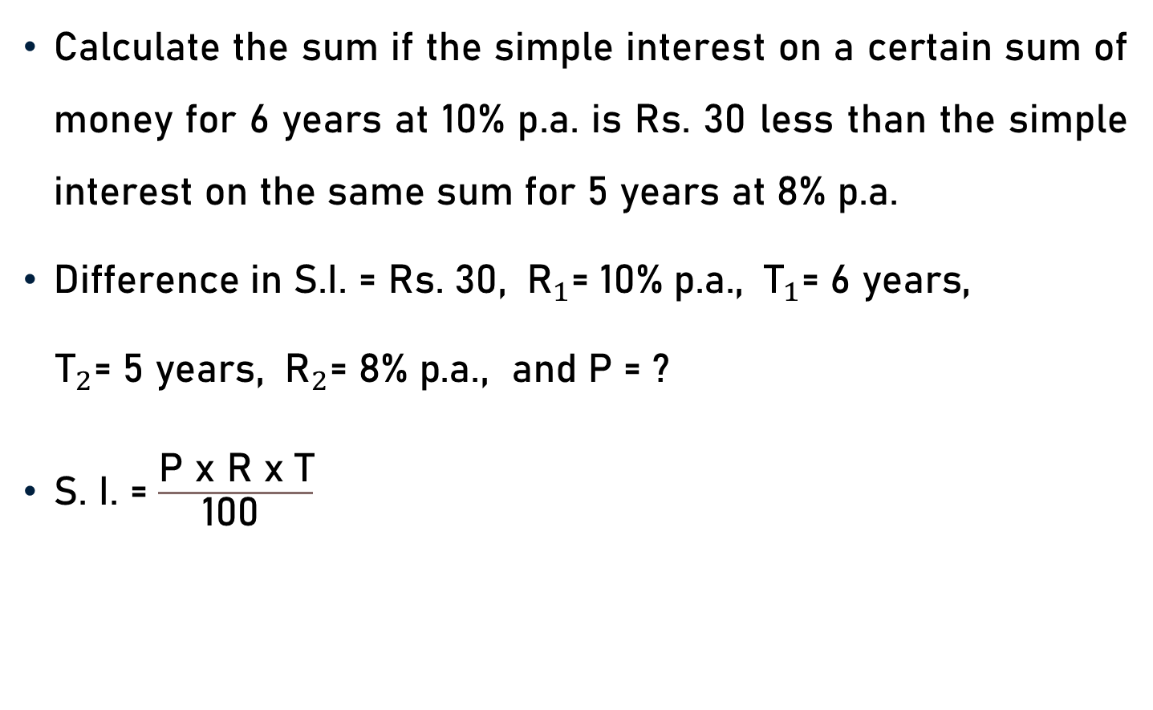
Problem 7
Calculate the sum if the simple interest on a certain sum of money for 6 years at 10% p.a. is Rs. 30 less than the simple interest on the same sum for 5 years at 8% p.a.
Difference in S.I. = Rs. 30, ${ \text{R}}_{1}\text{=}$ 10% p.a., ${ \text{T}}_{1}\text{=}$ 6 $\text{years}$,
${\text{T}}_{2}\text{=}$ 5 years, ${ \text{R}}_{2}\text{=}\text{ 8\% }\text{p}\text{.}\text{a}\text{.}$, and P = ?
S. I. = $\frac{\text{P} \text{x} \text{R} \text{x} \text{T}}{\text{100} }$

Slide 16
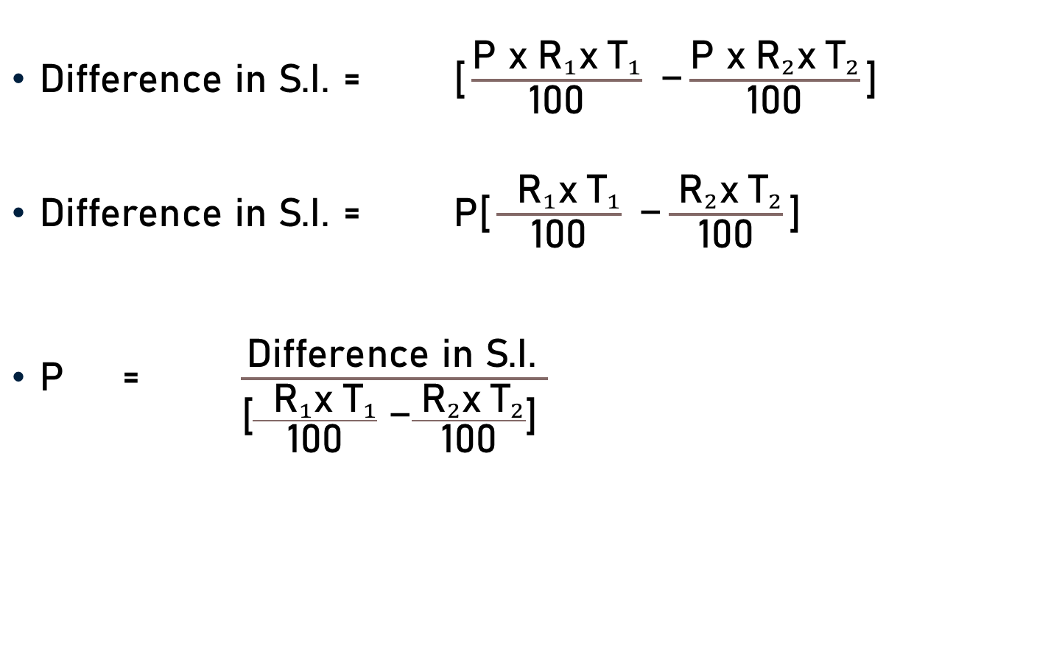
Problem 7
$\text{Difference} \text{in} \text{S}\text{.}\text{I}\text{.}$ = $\text{[}\frac{\text{P} \text{x}{ \text{R}}_{1}\text{x}{ \text{T}}_{1}}{\text{100}} \text{−}\frac{\text{P} \text{x}{ \text{R}}_{2}\text{x}{ \text{T}}_{2}}{\text{100}}\text{]}$
$\text{Difference} \text{in} \text{S}\text{.}\text{I}\text{.}$ = $\text{P}\text{[}\frac{ { \text{R}}_{1}\text{x}{ \text{T}}_{1}}{\text{100}} \text{−}\frac{{ \text{R}}_{2}\text{x}{ \text{T}}_{2}}{\text{100}}\text{]}$
$\text{P}$ = $\frac{\text{Difference} \text{in} \text{S}\text{.}\text{I}\text{.} }{\text{[}\frac{ { \text{R}}_{1}\text{x}{ \text{T}}_{1}}{\text{100}} \text{−}\frac{{ \text{R}}_{2}\text{x}{ \text{T}}_{2}}{\text{100}}\text{]} }$

Slide 17
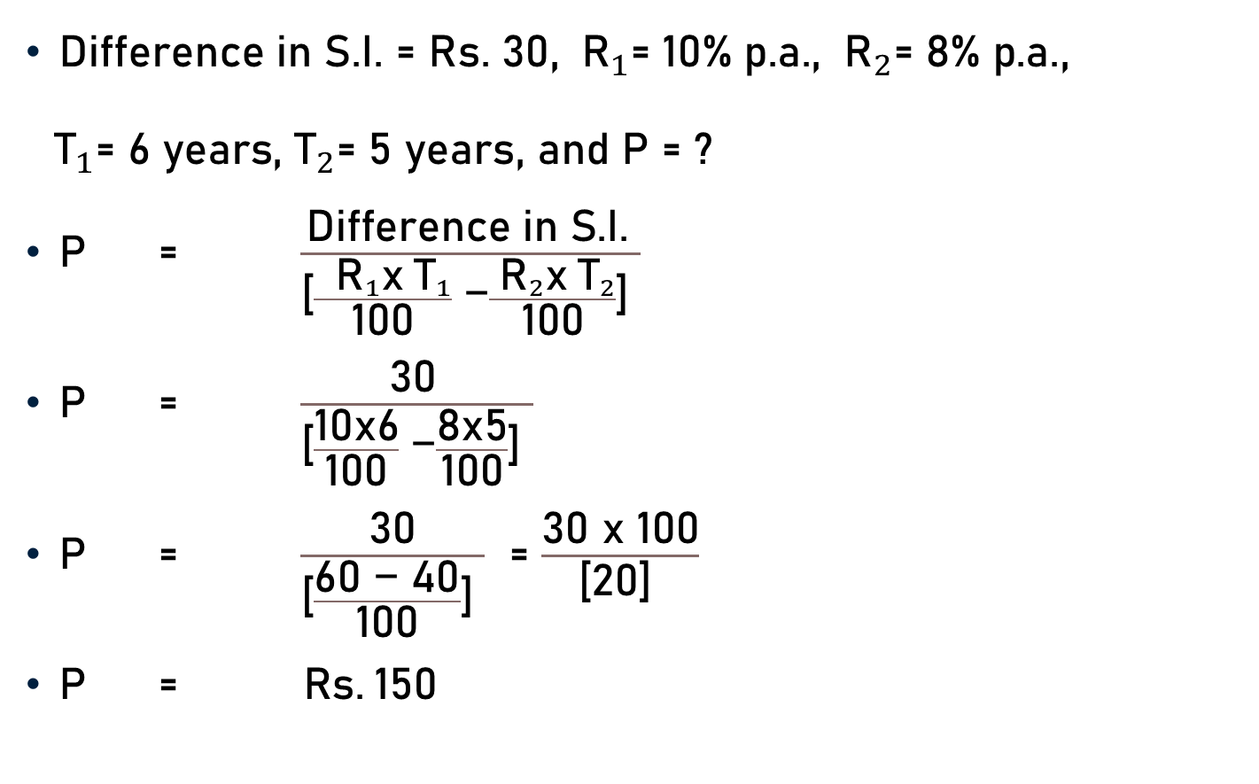
Problem 7
Difference in S.I. = Rs. 30, ${ \text{R}}_{1}\text{=}$ 10% p.a., ${ \text{R}}_{2}\text{=}\text{ 8\% }\text{p}\text{.}\text{a}\text{.}$,
${ \text{T}}_{1}\text{=}$ 6 $\text{years}$, ${\text{T}}_{2}\text{=}$ 5 years, and P = ?
$\text{P}$ = $\frac{\text{Difference} \text{in} \text{S}\text{.}\text{I}\text{.} }{\text{[}\frac{ { \text{R}}_{1}\text{x}{ \text{T}}_{1}}{\text{100}} \text{−}\frac{{ \text{R}}_{2}\text{x}{ \text{T}}_{2}}{\text{100}}\text{]} }$
$\text{P}$ = $\frac{\text{30} }{\text{[}\frac{\text{1}\text{0}\text{x}\text{6}}{\text{100}} \text{−}\frac{\text{8}\text{x}\text{5}}{\text{100}}\text{]} }$
$\text{P}$ = $\frac{\text{30}}{\text{[}\frac{\text{60}\text{ − 40}}{\text{100}}\text{]} }$ = $\frac{\text{30} \text{x} \text{10}\text{0}}{\text{[}\text{2}\text{0]} }$
$\text{P}$ = $\text{Rs}\text{.} \text{150}$
5
1

Slide 18
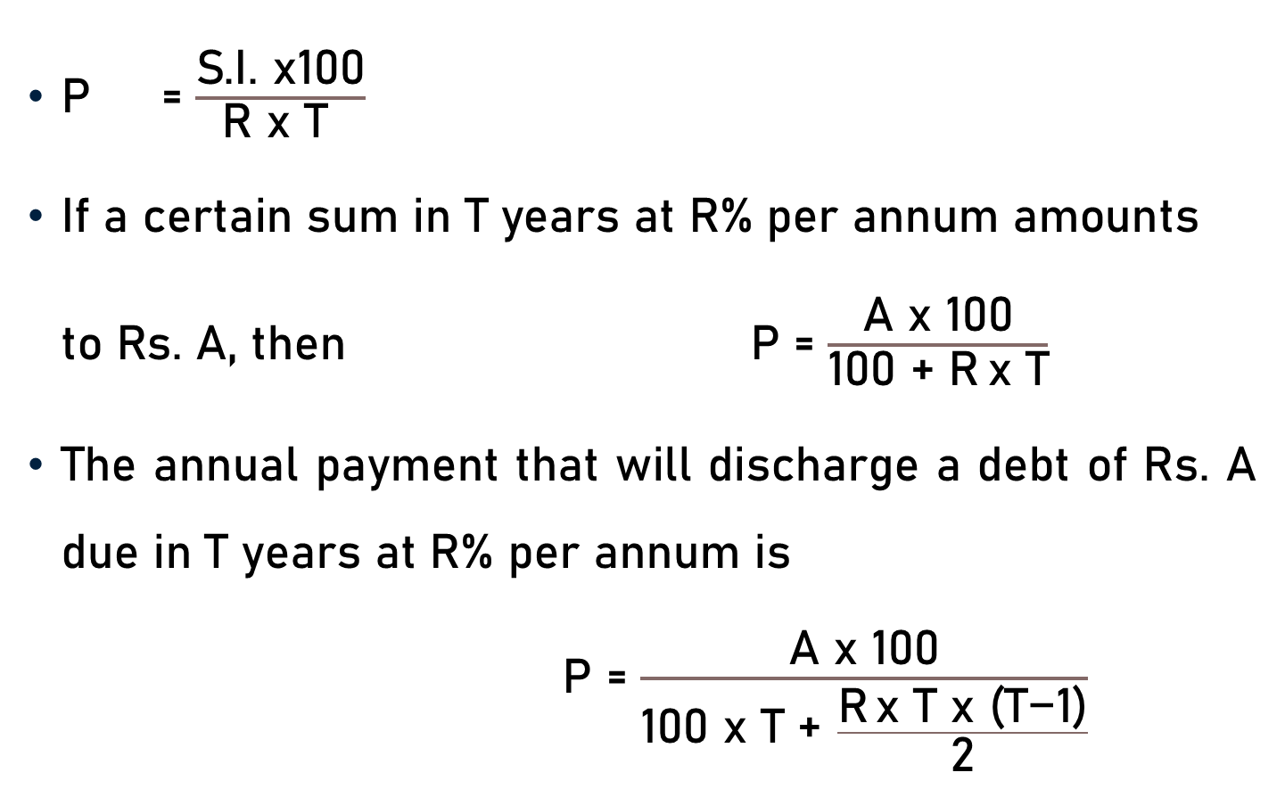
Conclusion
P = $\frac{\text{S}\text{.}\text{I}\text{. }\text{x}\text{100}}{\text{R} \text{x} \text{T} }$
$\text{If} \text{a} \text{certain} \text{sum} \text{in} \text{T} \text{years} \text{at} \text{R}\text{\% }\text{per} \text{annum} \text{amounts} \text{to} \text{Rs}\text{. }\text{A}\text{, }\text{then} \text{P}$ = $\frac{\text{A} \text{x}\text{ 100}}{\text{100 + }\text{R} \text{x} \text{T}}$
The annual payment that will discharge a debt of Rs. A due in T years at R% per annum is
$\text{P}$ = $\frac{\text{A} \text{x}\text{ 100}}{\text{100 }\text{x} \text{T}\text{ +} \frac{\text{R} \text{x} \text{T} \text{x}\text{ (}\text{T}\text{−1)}}{\text{2}}}$

Slide 19
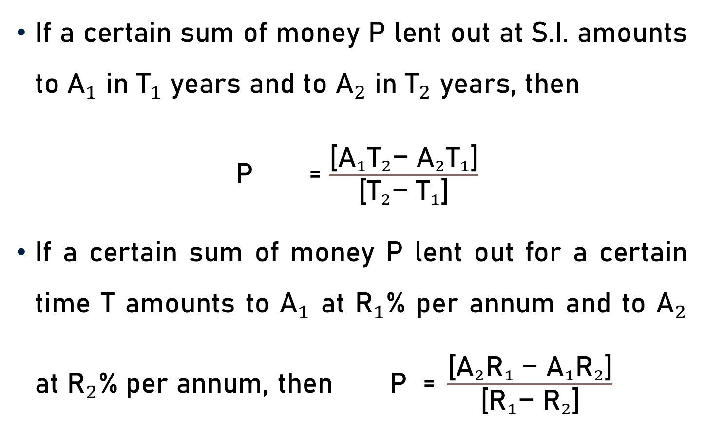
Conclusion
If a certain sum of money P lent out at S.I. amounts to ${\text{A}}_{1}$ in ${\text{T}}_{1}$ years and to ${\text{A}}_{2}$ in ${\text{T}}_{2}$ years, then
$\text{P}$ = $\frac{\text{[}{\text{A}}_{1}{\text{T}}_{2}\text{−} {\text{A}}_{2}{\text{T}}_{1}\text{]}}{\text{[}{\text{T}}_{2}\text{−} {\text{T}}_{1}\text{]}}$
If a certain sum of money P lent out for a certain time T amounts to ${\text{A}}_{1}$ at ${\text{R}}_{1}$% per annum and to ${\text{A}}_{2}$ at ${\text{R}}_{2}$% per annum, then $\text{P}\text{ = }\frac{\text{[}{{\text{A}}_{2}{\text{R}}_{1} \text{−} \text{A}}_{1}{\text{R}}_{2}\text{]}}{\text{[}{{\text{R}}_{1}\text{−} \text{R}}_{2}\text{]}}$

Slide 20

Conclusion
$\text{Original} \text{Sum} \text{of} \text{Money}$ (P) = $\frac{\text{A} \text{x}\text{ 100}}{\frac{{ \text{R}}_{1}}{\text{a}} \text{+}\frac{{ \text{R}}_{2 }}{\text{b}} \text{+}\frac{{ \text{R}}_{3}}{\text{c}}}$
$\text{P}$ = $\frac{\text{Difference} \text{in} \text{S}\text{.}\text{I}\text{.} }{\text{[}\frac{ { \text{R}}_{1}\text{x}{ \text{T}}_{1}}{\text{100}} \text{−}\frac{{ \text{R}}_{2}\text{x}{ \text{T}}_{2}}{\text{100}}\text{]} }$

Slide 21
Summary
Computation of Principal

